Slide 1
Getting Started on Office Addin with AngularJS and Yeoman
March 2016
John Liu

Slide 2

about John Liu
Senior Consultant
SharePoint Gurus Sydney
SharePoint Server MVP
Office Server and Services
User Groups,
SharePoint Saturday, SharePoint Conferences,
http://johnliu.net
@johnnliu
Notes:
Loves .NET, SharePoint & Windows Phone
Our team building event was to build a Pergola for John.

Slide 3
Contents
Office Dev: where we are, what’s new
Tools for JS
Office Add-In demo
dev.office.com
Ask questions

Slide 4
We are here now
SharePoint Add-Ins
API
  Use CSOM, JSOM
  Call REST and _api with Odata
Authentication
  Use FormDigest from the page
Tools
  VS.NET, sharepoint hosted apps, javascript apps, farm webparts

Slide 5
SharePoint add-ins
A new way to build extensions for SharePoint
Full page add-ins
Implement complete add-in experiences to satisfy business scenarios
Add-in parts
Create web parts that can interact with the SharePoint experience
Add-in commands
Add new commands to the ribbon and contextual menus
SharePoint dialog
Create contextual dialog from ribbon commands and item menus

Slide 6
What’s new in Office Dev?
New Tools
New APIs
New Auth

Slide 7
Tools: JS or CS
Javascript or C#
Visual Studio Code or Visual Studio .NET

Slide 8
Microsoft Graph
graph.microsoft.com (end points /beta, /v1)
graph.microsoft.io (documentation)
https://graphexplorer2.azurewebsites.net/
https://graph.microsoft.io/en-us/changelog
http://dev.office.com/blogs/Microsoft-Graph-WebHooks-Update-January-2016

Slide 9
Robust Microsoft Graph APIs
Designed for
openness and
flexibility
Enabling a
consistent
development
platform
Powering
a world
of devices
https://graph.microsoft.com
Documents
Mail
Calendar
People
Search
Office Graph
Groups
Notebooks
Videos
Social
iOS
dev.office.com
Notes:
Discuss the Office 365 APIs and their ability to provide connectivity into key O365 services (mail, calendar, files, notes, etc) from stand alone applications

Slide 10
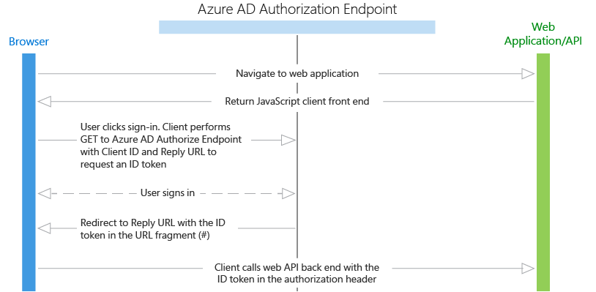
OAuth
https://azure.microsoft.com/en-us/documentation/articles/active-directory-authentication-scenarios/
Id_token

Slide 11
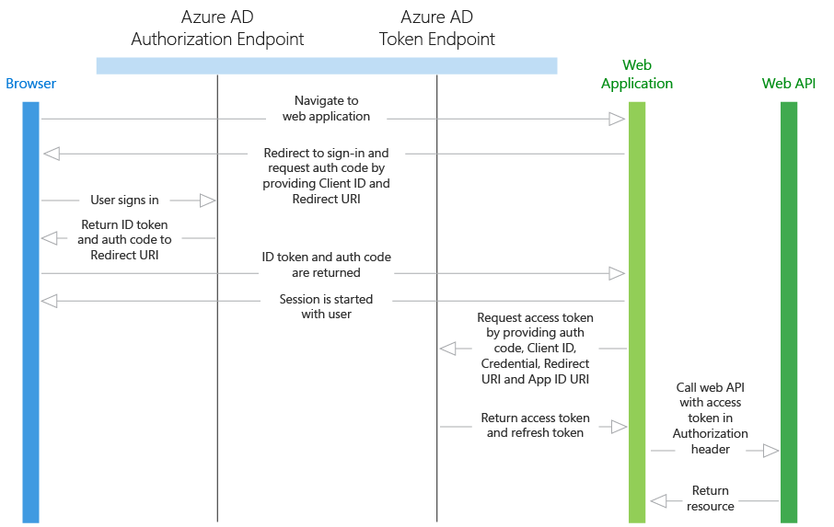
OAuth 2.0
Id_token
refresh_token
access_token
app-only
  https://github.com/OfficeDev/O365-Nodejs-Microsoft-Graph-App-only

Slide 12









Open platform
ADAL Library | ✔ | ✔ | ✔ | ✔ |  |  | ✔ | ✔ | ✔ | ✔ | ✔ | ✔ | ✔
Office 365 SDK | ✔ |  |  |  |  |  |  | ✔ | ✔ | ✔ | ✔ | ✔ | ✔
Dev.office.com samples | ✔ | ✔ | ✔ | ✔ | ✔ | ✔ | ✔ | ✔ | ✔ | ✔ | ✔ | ✔ | ✔
Azure AD and Office 365 offer Libraries/SDKs, but they are not mandatory as the platform is building on web standards such
as OAuth2, REST, and Odata.
Notes:
Yes, this is a busy slide, but the main points are:
We have SDKs (ADAL and O365 for most major platforms)
You don’t need SDKs to leverage Office 365 APIs given they follow standards like Oauth and REST
We offer a Yeoman Generator for building Add-ins outside of Visual Studio

Slide 13
Office Add-Ins
What is an Office Add-In…

Slide 14
Office add-ins
A new way to build extensions for Office
Contextual mail add-in
Add-in launched contextually from a mail message or appointment
Outlook and Outlook Web Access (OWA)
Task pane add-in
Add-in that runs beside a document/mail with read/write access
Word, Excel, PowerPoint, Project, Outlook
Content add-in
Add-in that runs within a document content with read/write access
Excel, PowerPoint, Access
Add-in command
Command in the Office UI to launch add-in or perform UI-less operation
Outlook, Outlook Web Access (OWA)

Slide 15
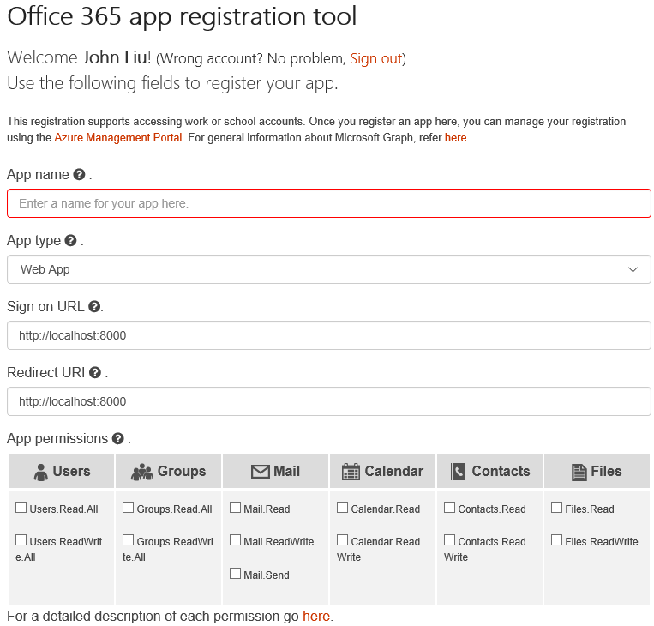
Register your app
Azure Management Portal – Azure subscription required
https://dev.office.com/app-registration free, limited permission options
https://apps.dev.microsoft.com/ free/preview not yet ready

Slide 16
Demo
Office Add-In

Slide 17
/demo
Beyond Desktop and Web
  iOS
  Mac
  Continuum
Adal-js
  Active Directory Authentication Library
Yeoman Generator
  Yo office
Office UI Fabric
  Word, Excel, desktop, mobile.
  ngOfficeUiFabric

Slide 18
dev.office.com
Documentation
Examples
Training
App Registration Tool
  http://dev.office.com/app-registration
Office Dev Podcast
  http://dev.office.com/podcasts
Office Dev Channel 9
  https://channel9.msdn.com/Shows/Office-Dev-Show
Team: Product Marketing
</>

Slide 19
Summary
Where we are, what’s new
Tools for C# and JS
Office Add-In demo
dev.office.com
Coming soon

Slide 20
New Upcoming Stuff
Kurvejs
V2 auth endpoint
  https://azure.microsoft.com/en-us/documentation/articles/active-directory-v2-compare/
AngularJS v2 and TypeScript
Outlook Addin for consumer Outlook.com
  https://blogs.office.com/2016/02/17/outlook-com-out-of-preview-and-better-than-ever/
Build Conference – 31/03 ~ 1/04
  http://build.microsoft.com/

Slide 21
Action
…

Slide 22
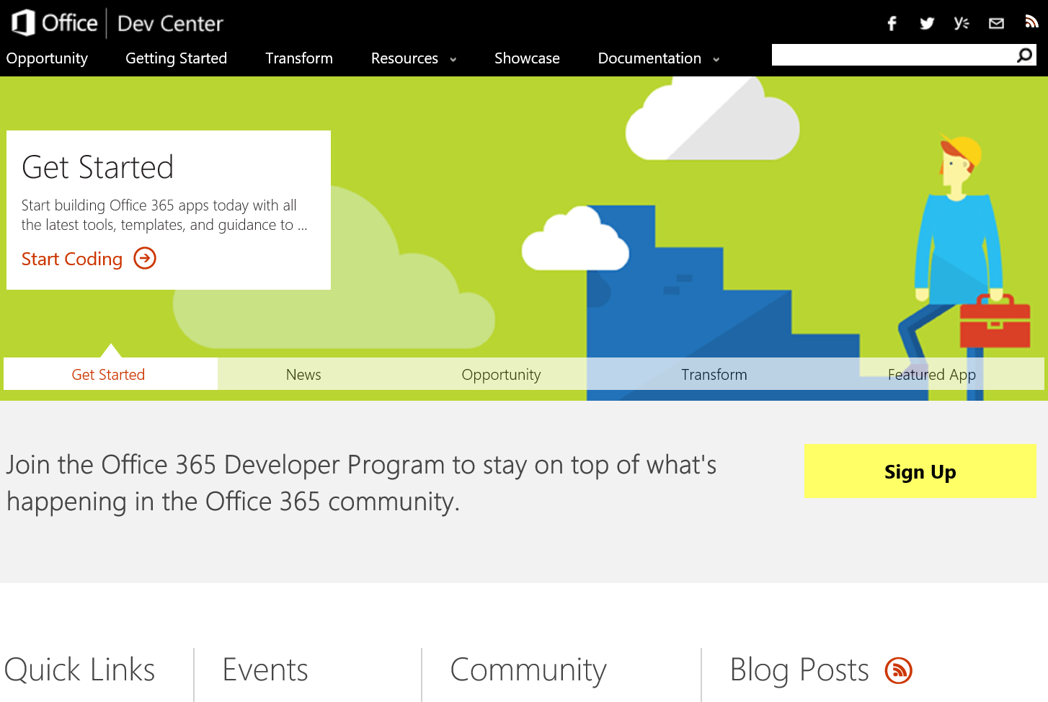
http://dev.office.com
dev.Office.com
Opportunity
Getting started
Transform
Resources
Showcase
Documentation
  http://dev.office.com/podcasts
  https://channel9.msdn.com/Shows/Office-Dev-Show

Slide 23
Virtual academy courses
Office 365 Development
Course 1: Introduction to Office 365 Development
Course 2: Deep dive into the Office 365 add-in model
Course 3: Deep Dive into integrating Office 365 APIs with your standalone web application development
Course 4: Deep Dive into integrating Office 365 APIs with your mobile device development
Course 5: Shipping your Office 365 add-in to the Office Store
Course 6: Deep dive into the building blocks and services of the SharePoint platform
Course 7: Deep Dive into Office 365 Development on non-Microsoft Stack
http://dev.office.com/training

Slide 24
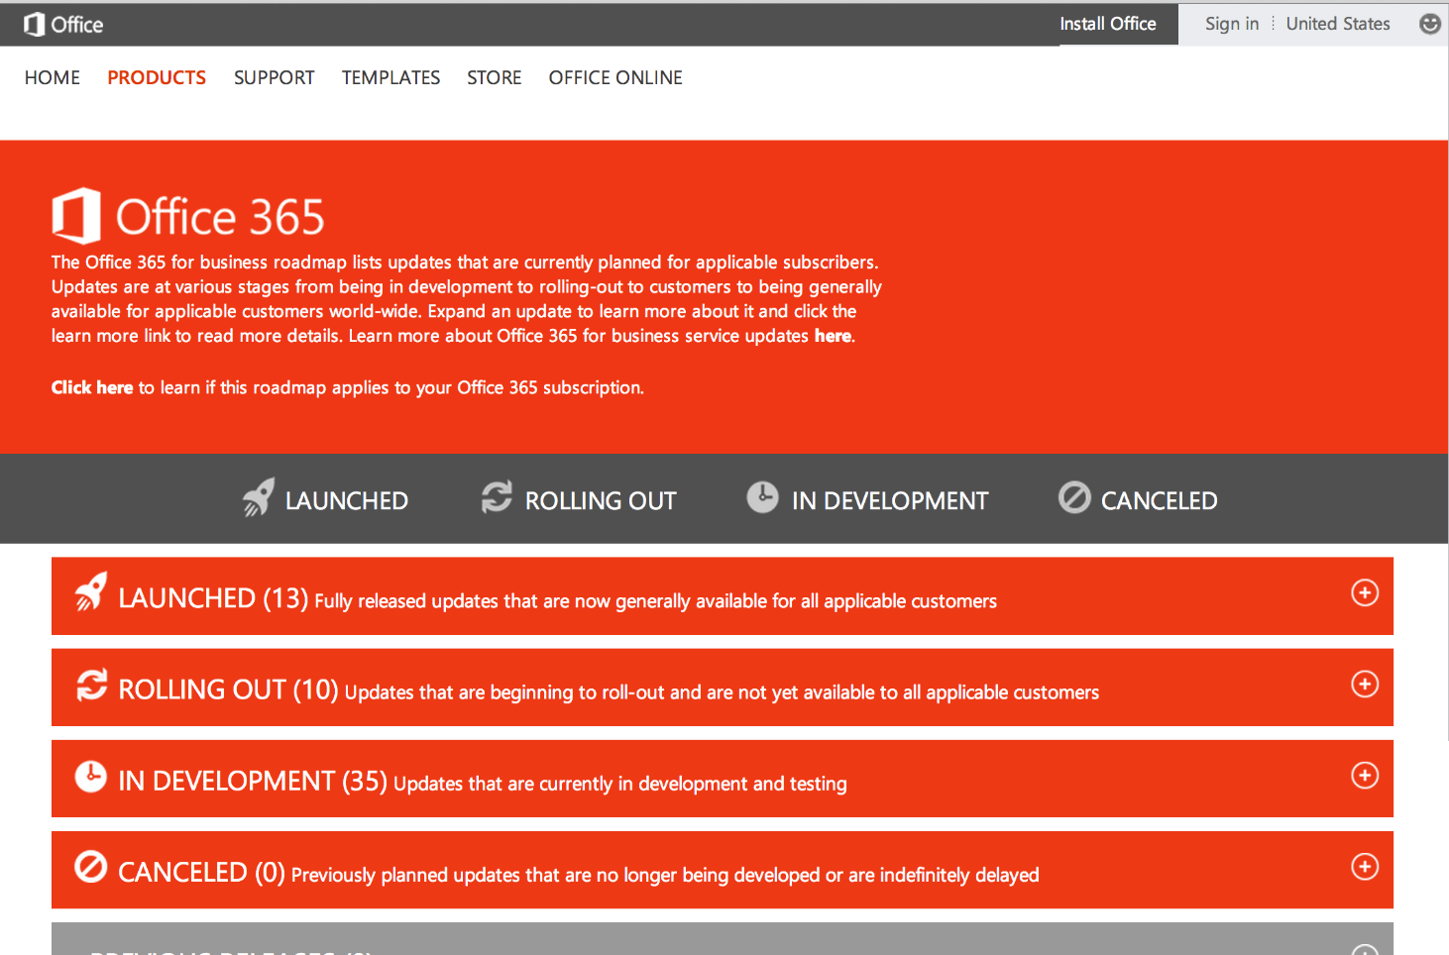
http://www.office.com/roadmap
dev.Office.com
Monthly updates
Developer features
Associated blog posts
Also: http://www.wictorwilen.se/

Slide 25
Thank you

