Slide 1
O365 Customization in the year 2017
A Cheatsheet

Slide 2
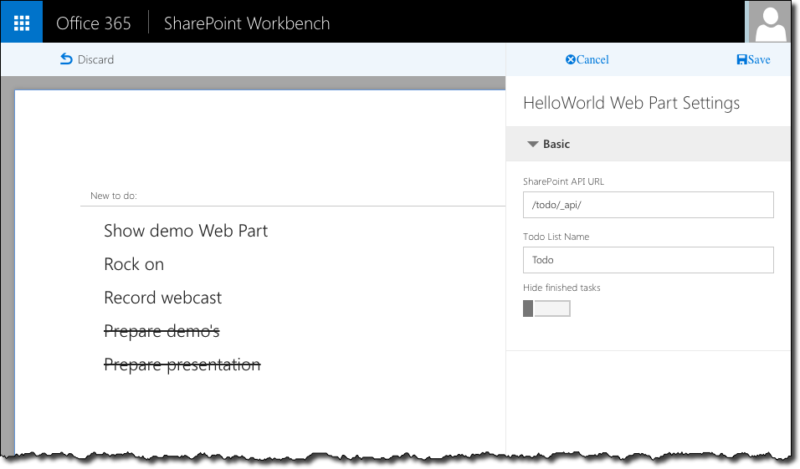
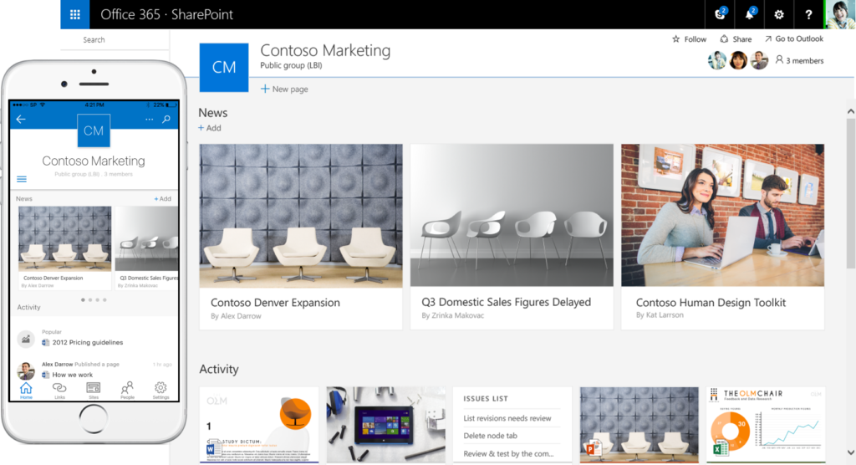
Sites, Webparts – SharePoint Framework

Slide 3
Sites, Webparts – SharePoint Framework
Open, modern web stack
GA in SPO
Supported in Modern sites
Works in Mobile
Coming to on-premises in future feature pack (2017?)

Slide 4
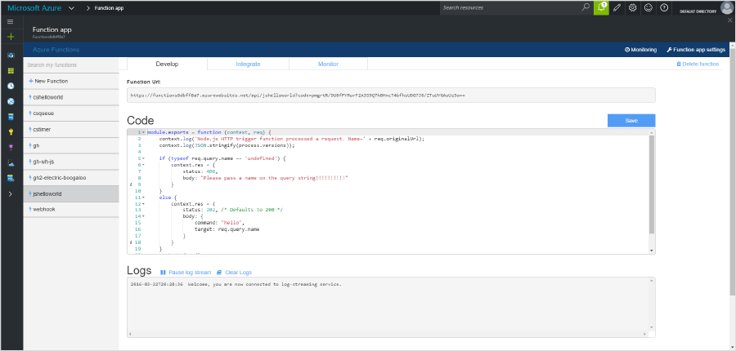
Server Code
Provider Hosted Apps
Azure Functions
Remote Event Receivers
Timer Jobs
Elevated Security

Slide 5
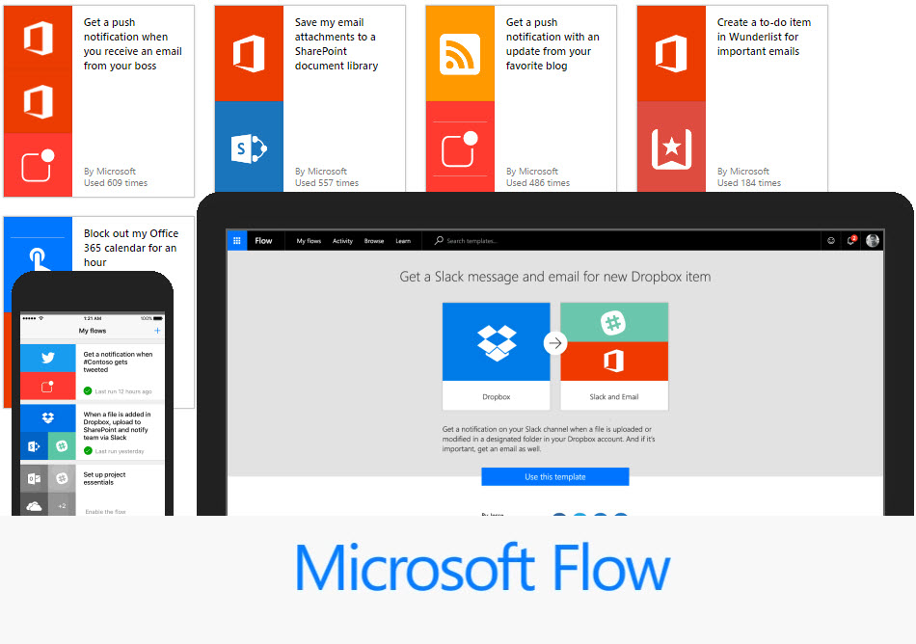
Workflow
Flow
Logic Apps
Azure Functions

Slide 6
Dashboard

Slide 7
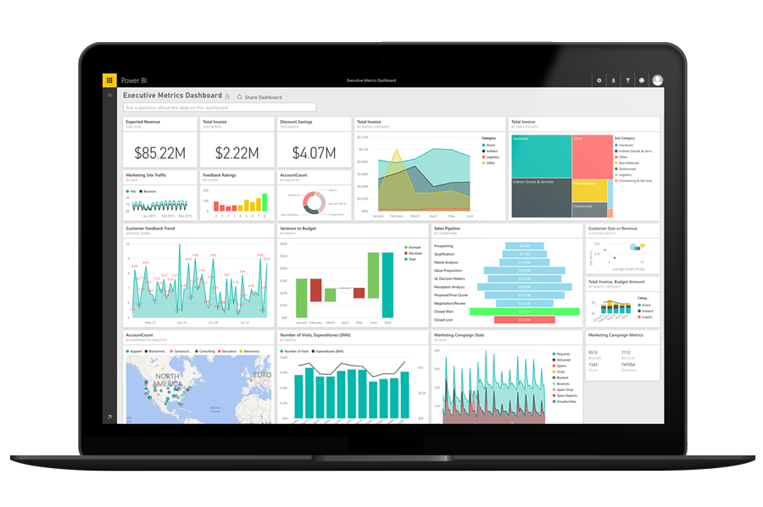
Dashboard
Power BI
Power BI webpart
Scheduled Refresh

Slide 8
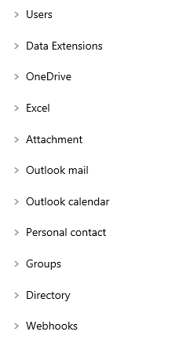
Microsoft Graph
SharePoint REST in beta
Lots of other resources

Slide 9
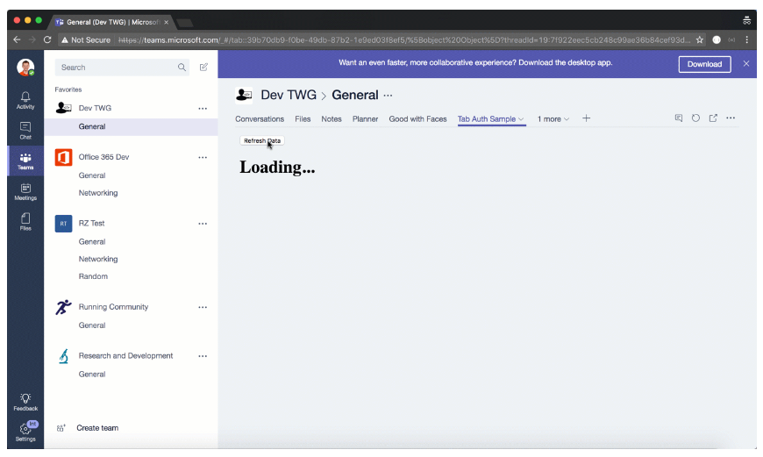
Office Add-ins
Outlook for Mac support
Microsoft Team

Slide 10
Bots and connectors
O365 Connectors
Bots
Skype Bots
Both work with Teams

Slide 11
Go Build
SharePoint List > Flow > Power BI > Dashboard
Skype > Bot Framework > Azure Functions > Timesheet (SharePoint)

Slide 12
Everyone is a Developer Now build amazing things

Slide 13
Forms
PowerApps
InfoPath?

