Slide 1
Introducing PhantomJS: Headless Browser for your SharePoint/Online
John Liu – SharePoint Gurus

Slide 2
Interest
In the past, I have talked to you about:
SPServices, JQuery + REST, KnockoutJS, TypeScript…
Today, I want to talk to you about
This would be either the best or at least the weirdest technology stack you might actually use with SharePoint/Online

Slide 3
You, the Audience
Developers
Power Users
Knowledge of Javascript is useful.
But I provide some example scripts and you can get what you want

Slide 4
Contents
What is PhantomJS
Installing PhantomJS and First Look
Demos!
Tips and Tricks
Advanced Scenarios

Slide 5
What is PhantomJS
PhantomJS IS NOT a Yet-Another-Javascript-Framework
PhantomJS IS a Browser
It is a headless browser
That you control with Javascript

Slide 6
Installation and First Look
Demo 0

Slide 7
Demo 0 - Summary
Bing.com is printed to file
Using Require to load modules.
var WebPage = require('webpage');
var page = WebPage.create();

Slide 8
Test Your SharePoint Customizations
Demo 1

Slide 9
Demo 1 Summary
page.includes(“url.to.js”)
page.injectJs(“filepath.to.js”)

Slide 10
Exporting SharePoint Pages to Document Library
Demo 1

Slide 11
Take Any Web Page to Document Library
List Forms
InfoPath Forms
Take output as png stream.
Add directly to sharepoint via REST API
I find this kind of shatters my sense of reality

Slide 12
Building a Site Directory with Thumbnails
Demo 2

Slide 14
Taking PDF Snapshots of Forms from Workflow
Demo 3

Slide 15
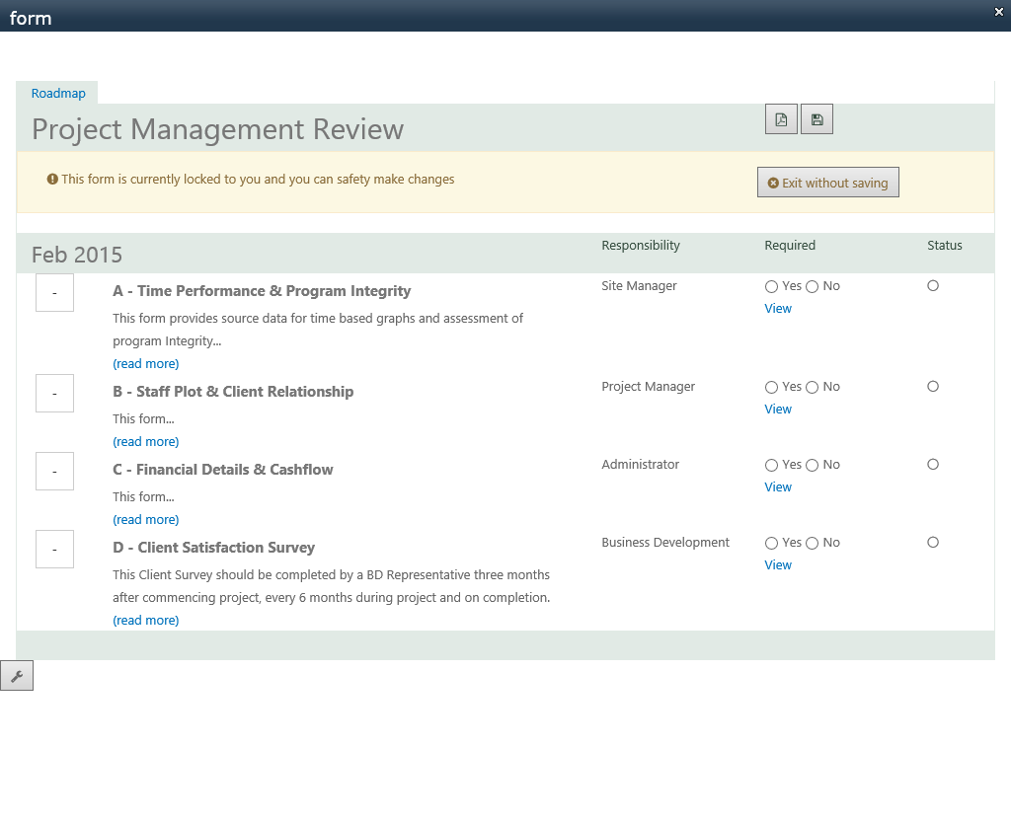

Slide 16
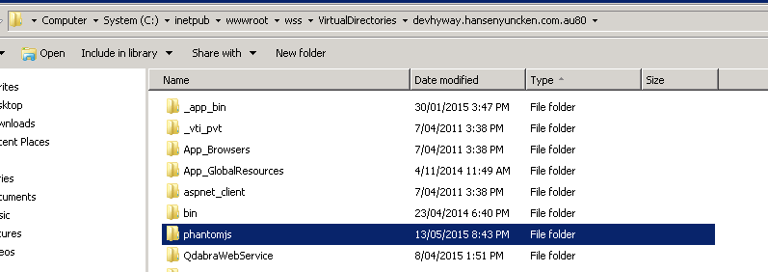
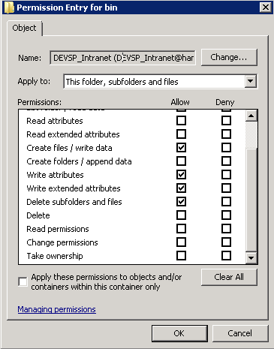

Slide 17
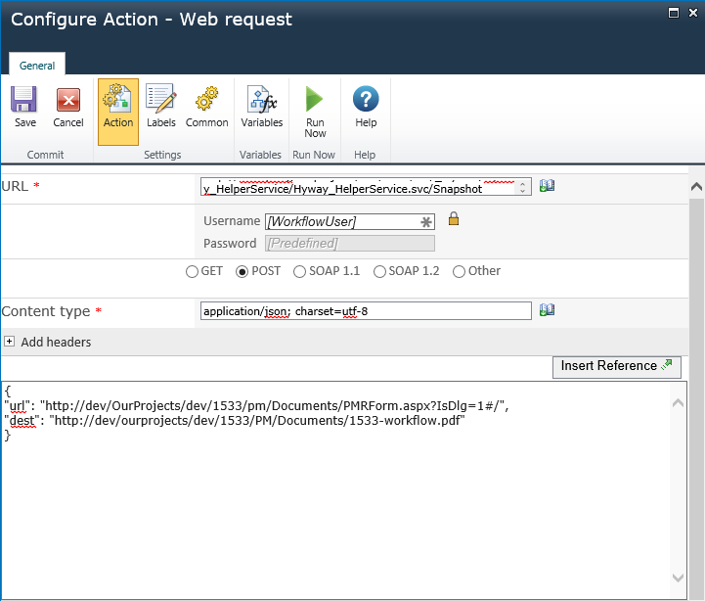
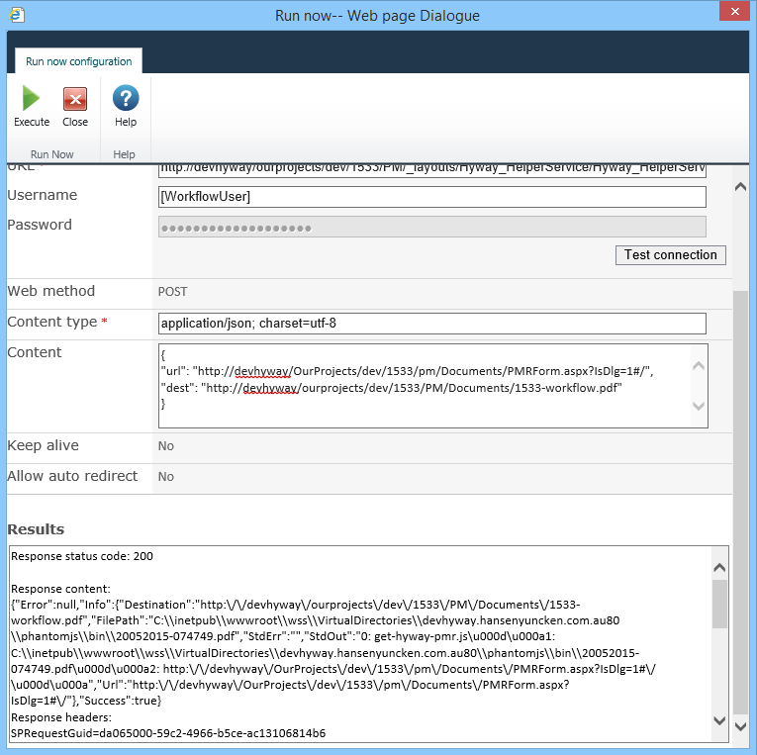

Slide 19
Demo 3 - Summary
Source Code
Screenshots

Slide 20
Checking Office 365 CSS Customizations
Demo 4

Slide 21
Demo 5 - summary
Why is this one last?
I’m not a fan of the way I did authentication
I think it can work better with Azure-AD login and tokens. But I haven’t figure this out.

Slide 22
Advanced Scenarios
Generating SPA Pages for Speed
Isomorphic JavaScript
http://nerds.airbnb.com/isomorphic-javascript-future-web-apps/
Scrapping Web Pages - no API
https://github.com/ariya/phantomjs/blob/master/examples/direction.js
https://github.com/ariya/phantomjs/blob/master/examples/follow.js
Automated Web Performance checking
http://yslow.org/phantomjs/
PhantomJS Server

Slide 23
Tips,Tricks and Traps
Use Page Background Colour
http://phantomjs.org/tips-and-tricks.html
Override Bootstrap media=@print

Slide 24
Background color and @print

Slide 25
Tips,Tricks and Traps

Slide 26
Remote Debugging
Demo 5

Slide 27
Tips,Tricks and Traps
Remote Debugging via webkit browser

Slide 28
Summary
We installed PhantomJS
We play through examples with SharePoint and Office 365
We talk about the future possibilities
We wrapped up with some Tips and Tricks
Thank you.
I hope you find PhantomJS as amazing as I do.
Definitely a very useful tool in your toolbox.

Slide 29
Thank You for listening Thank You Sponsors
John Liu
@johnnliu
John.liu@sharepointgurus.net

