Slide 1
Bravely Take your Skills to the Next Level: Office Add-Ins
John Liu
SharePoint Gurus
Notes:
Office Add-Ins is the new name for all things “Apps”. It represents a new thinking in how the Office Teams will provide pieces of the puzzles via APIs and components that will allow you to work across the entire suite of Office apps. Even to experiences beyond the browser.
To bravely step into this new world, you shouldn’t need to throw everything you know away. John will cover a roadmap of how you can take everything you already know in SharePoint and move into this brave new world.

Slide 2

about John Liu
Senior Consultant
SharePoint Gurus Sydney
SharePoint Server MVP
Office Server and Services
User Groups,
SharePoint Saturday,
SharePoint Conferences
http://johnliu.net
@johnnliu
Notes:
Loves .NET, SharePoint & Windows Phone
Our team building event was to build a Pergola for John.

Slide 3

Top Secret - Never Seen Photos
Notes:
This is a secret about John
These pictures will be deleted from the upload file
LEGO 6692 – 1983
LEGO 70165 - 2014

Slide 4
Contents
WebParts
Client-Side Web Parts
New things
  New thing 1
  New thing 2
  New thing 3
Office Add-Ins
Notes:
History – Web Parts
The future is Client-Side Web Parts (App-Parts or Addin-Parts) ;-)
Client-side web parts
(Written in JavaScript, runs on-premises, online, and Office Apps)
What we take for granted
Authentication
REST API
New things
Authentication and Authorization
New APIs
New tools

Slide 5

Server
Web Parts

Slide 6
Looking back
Farm Solutions
Sandbox Solutions
SharePoint “apps”

Slide 7
Now - Building A Client-Side WebPart
Too hard with raw JavaScript – take jQuery
(+KnockoutJS, AngularJS or ReactJS)
Call SharePoint’s service end points with /_api/ or listdata.svc (2010+) or even use Marc Anderson’s excellent SPServices (2007+)
Get the data as an array
Build HTML and add it to the UI

Slide 8
Demo
Build SharePoint Client-Side Web Part

Slide 9
Server
Web Parts
Client Side
Web Parts

Slide 10
SharePoint add-ins
A new way to build extensions for SharePoint
Full page add-ins
Implement complete add-in experiences to satisfy business scenarios
Add-in parts
Create web parts that can interact with the SharePoint experience
Add-in commands
Add new commands to the ribbon and contextual menus
SharePoint dialog
Create contextual dialog from ribbon commands and item menus

Slide 11
Next:
The new auth

Slide 12
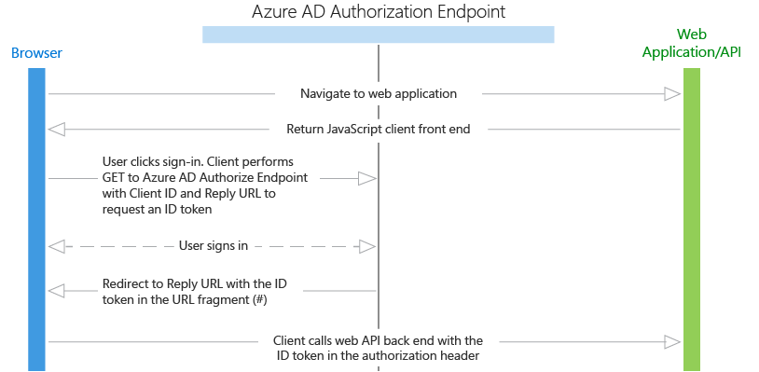
OAuth
https://azure.microsoft.com/en-us/documentation/articles/active-directory-authentication-scenarios/
Id_token

Slide 13
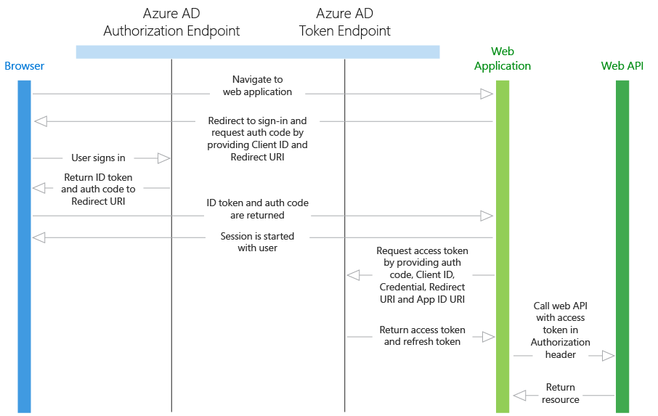
OAuth 2.0
Id_token
refresh_token
access_token
app-only
  https://github.com/OfficeDev/O365-Nodejs-Microsoft-Graph-App-only

Slide 14
Next:
New APIs

Slide 15
Microsoft Graph
graph.microsoft.com (end points /beta, /v1)
graph.microsoft.io (documentation)
https://graphexplorer2.azurewebsites.net/
https://graph.microsoft.io/en-us/changelog
http://dev.office.com/blogs/Microsoft-Graph-WebHooks-Update-January-2016

Slide 16
Robust Microsoft Graph APIs
Designed for
openness and
flexibility
Enabling a
consistent
development
platform
Powering
a world
of devices
https://graph.microsoft.com
Documents
Mail
Calendar
People
Search
Office Graph
Groups
Notebooks
Videos
Social
iOS
dev.office.com
Notes:
Discuss the Office 365 APIs and their ability to provide connectivity into key O365 services (mail, calendar, files, notes, etc) from stand alone applications

Slide 17
Next:
New Tools

Slide 18
Demo
Build SharePoint Addin-Part to talk to Graph
  Groups
  Search

Slide 19
Server
Web Parts
Client Side
Web Parts
New Tools
New APIs
New Auth

Slide 20
What is Office Add-in?

Slide 21
Office add-ins
A new way to build extensions for Office
Contextual mail add-in
Add-in launched contextually from a mail message or appointment
Outlook and Outlook Web Access (OWA)
Task pane add-in
Add-in that runs beside a document/mail with read/write access
Word, Excel, PowerPoint, Project, Outlook
Content add-in
Add-in that runs within a document content with read/write access
Excel, PowerPoint, Access
Add-in command
Command in the Office UI to launch add-in or perform UI-less operation
Outlook, Outlook Web Access (OWA)

Slide 22
Build them in exactly the same way
Demo
Extend SharePoint Add-In to be Office Add-in

Slide 23
Server
Web Parts
Client Side
Web Parts
Office Add-Ins
New Tools
New APIs
New Auth

Slide 24
/demo
Beyond Desktop and Web
  iOS
  Mac
  Continuum
Adal-js
  Active Directory Authentication Library
Yeoman Generator
  Yo office
Office UI Fabric
  Word, Excel, desktop, mobile.
  ngOfficeUiFabric

Slide 25
Summary
Where we are, what’s new
Client-side Web Part demo
SharePoint Add-In demo
Office Add-In demo
New Auth
New API
New Tools
But it’s all just evolved, and now far more flexible

Slide 26

Future Watch
Azure Functions (this is so hot and so new!)
Azure AD v2 Auth End Point
AngularJS 2.0
  ngOfficeUiFabric
TypeScript 1.8

Slide 27
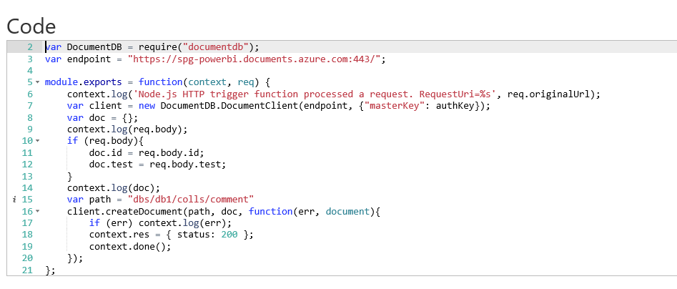
Azure Functions

Slide 28
Call to Action
Follow one of many examples (C# or JS) on dev.office.com and grab an Auth token, then call the API that you fancy:
Try OneNote, or even Excel (beta)
Or grab my 3 example codes and try to run them. But you need get your feet wet.

Slide 29
Q&A
John Liu
john.liu@sharepointgurus.net

