Slide 1
Creating Knockout User Experiences in SharePoint with JavaScript
Making awesome with Knockout, jQuery and SharePoint REST

Slide 2
Plugs
John Liu - I work with SharePoint Gurus in Sydney. We are a consultancy that delivers awesome SharePoint solutions for our happy clients.
Australian SharePoint Conference - March 20-21, in Melbourne. I'm covering a developer topic on custom REST services and Knockout.
SharePoint Saturdays later in the year TBA
InfoPath is cool. Don't diss InfoPath :-(

Slide 3
Contents
Demo, demo, demo (5 demos)
Tricks
Risks
Related techniques

Slide 4
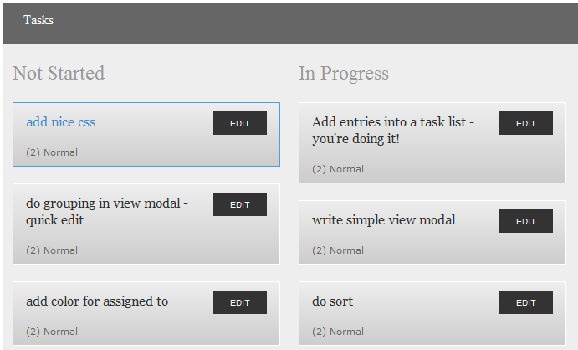
Picture - build this in 1 sesson

Slide 5
Demo - ko
… 0

Slide 6
Demo - ko.mapping
… 1

Slide 7
Demo - SP2010 REST
… 2
listdata.svc
GET interface

Slide 8
Demo - SP2010 REST
… 3
POST
MERGE
Remember e-tag

Slide 9
Demo - crazy
… everything!

Slide 10
Current issues
Debugging is not as great as Visual Studio. You'll need to know how to use the browser's JavaScript debugger fairly well
Not all binding errors show up in the console log - sometimes you only see an error when you debug
It is possible to create circular dependency graphs and then your JavaScript will slow to a dog!

Slide 11
Tricks
IE developer toolbar
Using HTML inspector
Using JavaScript debugger
Using Network inspector

Slide 12
Risk: Is this mainstream?
Knockout is created as an open source project, by Steve Sanderson. Who is actually a Microsoft Program Manager in the ASP.NET team.
There are other template engines but they aren't as mature - some are still in beta. Knockout is stable and in version 2 already.
Has been proven to work for ASP.NET WCF, ASP.NET MVC, Ruby on Rails, and now SharePoint ;-)
Knockout supports other template engine as plugins.

Slide 13
Risk: looks difficult to learn
A good grasp of the concepts is the right starting point - hopefully I've provided that
Next, go through the demos and experiment, and use that as a reference to build your own creations

Slide 14
What about if you can't use REST?
You can use it with the client object model, load SPItem via SP.ClientContext and then use ko.mapping
For SP2007, you can also use SPServices.codeplex.com which is a JavaScript wrapper library around SharePoint 2007/2010 SOAP Services
You can also use KO with your own custom REST services

Slide 15
Whoa! We don't do dirty Content Editor webparts!
Take the entire content of the html file, and put it into a sandbox visual web part. This will create a sandbox solution and you can deploy that within your site collection.

Slide 16
Cool pictures

Slide 17
Downloads
Knockout: http://knockoutjs.com/
Knockout.Mapping: https://github.com/SteveSanderson/knockout.mapping/tree/master/build/output

Slide 18
References
SP2010 REST - http://msdn.microsoft.com/en-us/library/ff798339.aspx
http://knockoutjs.com/documentation/introduction.html
https://www.nothingbutsharepoint.com/sites/devwiki/articles/Pages/Applying-the-MVVM-pattern-to-create-SharePoint-list-driven-interactive-tools-using-Knockout.aspx
https://www.nothingbutsharepoint.com/sites/devwiki/articles/Pages/SharePoint-Development-Using-HeadJS-KnockoutJS-And-SPServices.aspx

Slide 19
References
SPServices - https://www.nothingbutsharepoint.com/sites/eusp/Pages/jQuery-Library-for-SharePoint-Web-Services-(SPServices)-v0.7.1-Released-.aspx

Slide 20
Summary
Saw lots of demos
Tricks
Risks
Related techniques

Slide 21
http://johnliu.net
@johnnliu (twitter)

