Slide 1
Building SharePoint solutions with Microsoft’s TypeScript: how and why.
John Liu

Slide 2

about John Liu
Senior Consultant for SharePoint Gurus Sydney
http://johnliu.net
Community: user groups, SharePoint Conferences and SharePoint Saturday
@johnnliu
Loves .NET, SharePoint & Windows Phone
Video games, board games, D&D
Notes:
Keith (geek in training), cheating his dice roll while I'm taking this picture because he didn't get enough skulls to hit the ogre.

Slide 3
Contents
What is TypeScript
Why, oh why another scripting language!
How
Demo
PInteresp

Slide 4
What is TypeScript
Free and Open Source, strongly supported by Microsoft
TypeScript is based on ECMAScript 4 with ECMAScript 6 proposals
A superset of JavaScript
To understand why we need JavaScript+, we need to understand what's wrong with vanilla JavaScript.

Slide 5
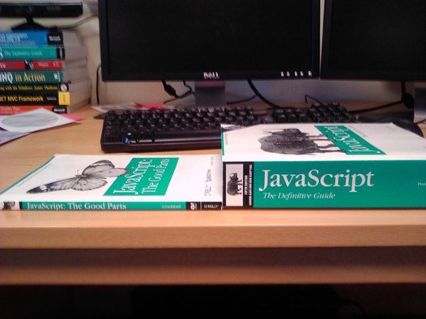
What is the problem with JavaScript
Why do people hate working in JavaScript?

Slide 6
What…
JavaScript is designed as a scripting language to do small things on a browser document.
We are now trying to make it do all sort of things, a "page" can be the application, and all logic runs in JavaScript.
AJAX and REST end points allow us to communicate to the server without refreshing the page.
As JavaScript code gets complex, it is extremely unwieldy.
Who is using lots of JavaScript in their project now?
What libraries are you using?

Slide 7
JavaScript problems - dynamic types
Variables are untyped and dynamic.
Dynamic types are great, because you don't always know what type the object you get is. Or if you have an inline object.
It's bad because it is so, so easy to get wrong.
var x = 1; var y = x + 1; // this is OK, type is inferred. We can assume then x and y are both numbers.
var x = 1; x = "hello"; // this is NOT OK, type is mixed up. We can't assume what type is x. // this is an old problem, the solution to this in VB is: var intX; // and then someone in your team will do…
intX = "hello"; // I am most guilty too - var i, j, k, x, y, z, a, b, c, i1, i2; // who knows what they are! // being an interpreted language, no compiler warnings

Slide 8
JavaScript problems - object extension, not class-based
JavaScript is based on object. It is easy to create and extend existing objects.
This is great, because you aren't restricted to defining your object at compile time only.
It's bad because it is so, so easy to get wrong.
var x = { a : 1, B : 2 } console.log(x.a + x.b);
var x = { a : 1, b : 2, a : 3 } console.log(x.a + x.b);
// being an interpreted language, no compiler warnings

Slide 9
JavaScript problems - parameters
When you define a function with arguments. That is your contract with your caller. Unfortunately, in JavaScript, function parameters are more like guidelines
Coupled with the untyped nature of JavaScript, your day is only going to get worse.
function f(x) { return x + 1; }
f("hello"); f(1234); f(); f(function(){}); f([4]); f("hello", "world");
// and then we have this magic object. function f() { console.log(arguments.length); } f(1,1,2,2);
// yes, magic. Where did arguments come from? // You get defensive and check all params, or don't and your code could crash and burn // It's bad because it is so, so easy to get wrong.

Slide 10
JavaScript problems - scope
JavaScript's scope is wonderful, but unlike C# it is not at a block level. It is at the function level.
The problem though, is that it is still, so, so easy to get wrong.
var foo = 1; function x() { foo = 2; } x(); console.log(foo);
var foo = 1; function x() { var foo = 3; } x(); console.log(foo);
var foo = 1; var y; function x() { var foo = 2; y = function(){ foo = 3; } } x(); y(); console.log(foo);
// y is function closure - exposes an inner function, allowing the inner variable x.foo to be modified externally.
// extremely important in event handling, but difficult without strong coffee.
Notes:
// not a reference to coffeescript

Slide 11
JavaScript problems - hoisting
Hoisting is essentially a scoping problem, in almost ALL cases, you don't want this behaviour.
var foo = 1; function x() { foo = 2; var foo = 3; } console.log(foo); // what is foo? // what is x.foo?
var foo = 1; function x() { var foo; foo = 2; foo = 3; }

Slide 12
Let's look at TypeScript
Enough pain (or fun)
Let's look at TypeScript, first the basics

Slide 13
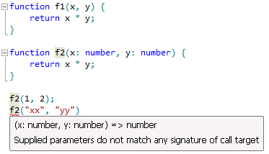
TypeScript - first glance - strong type checking
// js function f(x, y) { return x * y; }
// ts function f(x : number, y : number) : number { return x * y; }
// Type information is enforced in design and
// compile time, but removed at runtime

Slide 14
TypeScript - demo.ts
see demo.ts

Slide 15
TypeScript - Interfaces
// ts interface

Slide 16
TypeScript features
Bringing structure and static type checking at compile time
Modules to define scopes and export to specify what are public
Interface and Class to provide traditional Object Oriented Programming
Works with all your existing JavaScript libraries
Low learning overhead compared to other JavaScript improvement systems (CoffeeScript or Dart)

Slide 17
How - new projects
Visual Studio 2012
SharePoint Solutions and Sandbox Solutions
Visual Studio 2010

Slide 18
TypeScript - pinteresp.ts
see pinteresp.ts

Slide 19
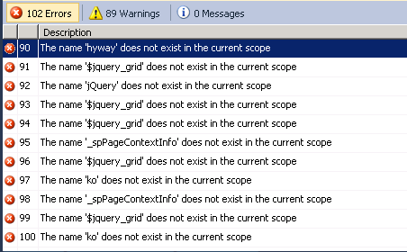
How - existing projects - practical guidelines
I have spaghetti JavaScript how do I update them to TypeScript?
This is a production javascript file (1500 lines)
#1 copy the JS file and paste into a TS file.

Slide 20
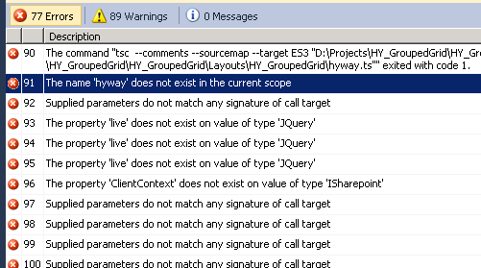
How - existing projects
#2 Add <reference> for definition files
#3 Fix optional arguments in functions.
#4 Fix ad-hoc objects to match definition interfaces.
#5 Create missing definitions (e.g. JQuery.map, SP.ClientContext)
Majority of errors are TypeScript asking you to describe the interface better.

Slide 21
How - existing projects
#6 Fix all errors that TS is complaining about.
Other small issues - I should blog these.
Fix deprecated method references (JQuery.live should be JQuery.on)
Fix String.format
Fix Date - Date
#7 Moving all the Utility functions into a separate scope. Move them out into a commonly shared file. You should also add Type information and jsdoc comments for them.
#8 You can also use F2 rename symbol to finally standardize the variable names in your JavaScript, without fearing things would break

Slide 22
How - existing projects
#9 You don't have to start with your largest file. Start with the smaller file.
Congratulations you are on your way to cleaner, maintainable code

Slide 23
Summary - why TypeScript
Have to learn one more thing - there is a learning curve, very easy if you already know JavaScript, or if you know C# very well.
You still have to learn JavaScript - Understanding how TypeScript converts to JavaScript will teach you better JavaScript
Some definition files don't exist or incomplete, but I think this will vanish very quickly. These aren't hard to write if you really need something.
Visual Studio is amazing
Modules and classes enable large projects and code reuse
Compile-time checking prevents errors
Definition files for common JavaScript libraries makes them very easy to work with, and provides strong type checking
Source map debugging makes debug easy

Slide 24
Conclusion - if I have to make a decision for you…
If you see yourself using more JavaScript. You have to look at TypeScript.
If you and your team has to work on JavaScript together, you have to look at TypeScript.
Once you've done the initial hard work and converted a project. You can't stand going back.
TypeScript is currently in beta. There are occasionally bugs. But the forums and support (in Stack Overflow) is very good.
But they are moving very quickly. v0.9 will give us generics! I expect to see strong take-up of TypeScript in MS community.
You can use TypeScript for ASP.NET / MVC / SharePoint as well as Windows Apps
Notes:
If you are already using JavaScript, and you see yourself using more JavaScript. You have to look at TypeScript.
The strong tooling in Visual Studio is a key differentiator for Microsoft. TS will be here at least until ECMAScript v6 comes out, whenever that is. Even then, old browsers won't support most of it so you'll still need a way to compile down to plain-old-JavaScript
Once you've done the initial hard work and converted a project. There is no going back. It'd be like going back to the dark ages.
TypeScript is currently in beta. v0.9 will give us generics! I expect as TS matures and more and more Microsoft teams migrate to it internally, we'll see a lot more TS in one year than now.
You can use TypeScript for ASP.NET / MVC / SharePoint as well as Windows Apps

Slide 25
Questions?
Comments?
More info
John.Liu@SharepointGurus.net
@johnnliu http://JohnLiu.net
Feedback please!

Slide 26
References - TypeScript
http://www.typescriptlang.org/
http://channel9.msdn.com/Shows/Going+Deep/Anders-Hejlsberg-and-Lars-Bak-TypeScript-JavaScript-and-Dart
https://github.com/borisyankov/DefinitelyTyped
http://www.slideshare.net/jeremylikness/introduction-to-typescript
http://prezi.com/zkhsz49ownaw/coffeescript-vs-typescript/

Slide 27
References - SharePoint + TypeScript
http://www.chaholl.com/archive/2013/01/03/typescript-in-a-sharepoint-farm-solution.aspx
http://www.chaholl.com/archive/2013/02/18/a-collection-of-typescript-definition-files-for-sharepoint-2013-et-al.aspx
http://johnliu.net/blog/2013/2/26/typescript-and-sharepoint-definition-files.html

Slide 28
References - JavaScript
http://javascript.crockford.com/javascript.html
http://javascript.crockford.com/inheritance.html
http://www.adequatelygood.com/2010/2/JavaScript-Scoping-and-Hoisting
http://www.jibbering.com/faq/notes/closures/

Slide 29
Thanks for listening
Remember to submit your feedback so you go in the draw to win prizes at the end of the day

