Slide 1
Custom REST services and jQuery AJAX
Building your own custom REST services and consuming them with jQuery AJAX

Slide 2
Building your own custom REST services and consuming them with jQuery AJAX
Custom REST services and jQuery AJAX

Slide 3
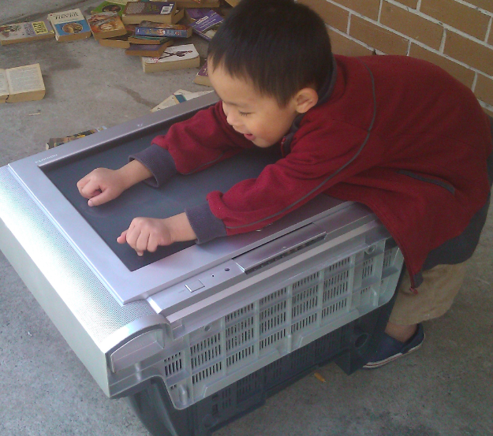
about John Liu
Surface!
Senior Consultant for SharePoint Gurus
Blogging
User Groups, SharePoint Conferences and SharePoint Saturday
Loves .NET
SharePoint 2007, 2010, Silverlight & Windows Phone
Notes:
MS surface joke

Slide 4
Contents
Intro
  jQuery
  REST API (out of the box)
Create SOAP service
Create REST service
Highly responsive websites with jQuery AJAX
Create ADO.NET DataService

Slide 5
Intro - jQuery in 1 slide
JavaScript library
Select using CSS rules, then do something with the selected set
Lots of helper functions, utilities
Externally injected so doesn’t interfere with how SharePoint works
$("div.mybox").addClass("yourbox").show();
http://jquery.com/

Slide 6
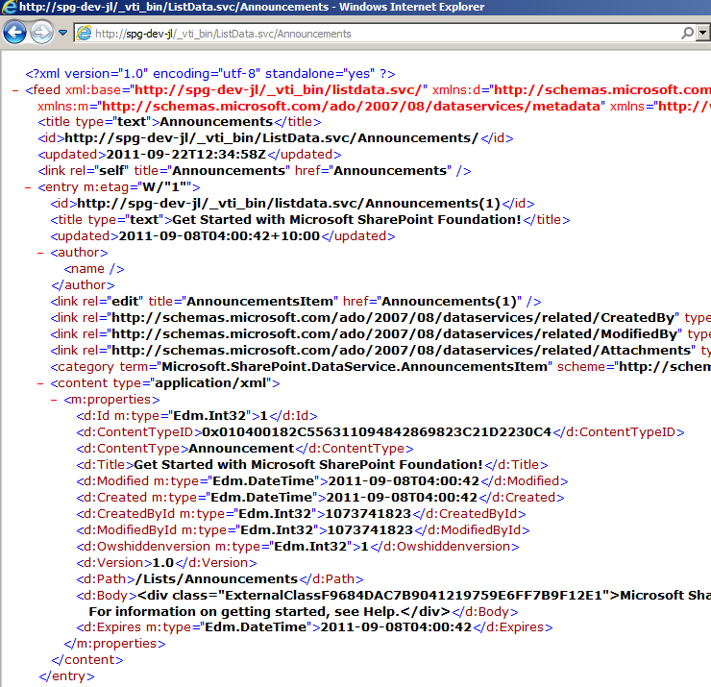
Intro - SharePoint REST API
/_vti_bin/ListData.svc/

Slide 7
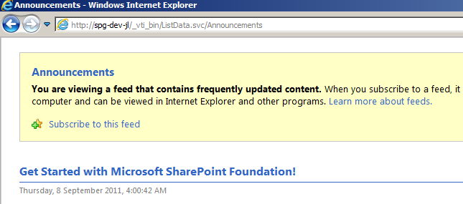
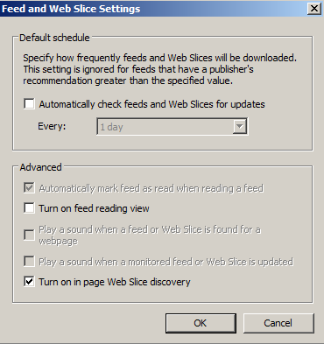
Quick tip with IE
If you see this, IE is trying to be helpful
Uncheck!

Slide 8
What are REST useful for?
Within SharePoint - not much
With other applications - extremely useful
Very simple interface that many 3rd party apps know how to talk
  Phone apps, JavaScript apps
  Reporting apps, integration apps
  SOAP is a lot more complex with creating the right SOAP envelop
  REST is easy as long as you can make a web page request

Slide 9
Question before demo
How many have written webparts for SharePoint
How many have build your own WCF services at some point?
In SharePoint?

Slide 10
Write your own SOAP and REST services
Code Demo
Notes:
Write your own SOAP and REST services
Create soap service
Deploy and see the /mex
Issues with binding
Create REST service
Look at the result
What we can do in REST – full SPContext
Create a dumb web part
Smarts in javascript.
See result
See Javascript
Network payload
JavaScript debugging
PUT service
DataService

Slide 11


Building your own WCF services
Useful for InfoPath
The problem with WCF:
Error “This collection already contains an address with scheme http”
Configuration necessary in web.config
Use Microsoft.SharePoint.Client.Services.MultipleBaseAddressBasicHttpBindingServiceHostFactory
Notes:
WCF service can only have 1 base address header
Can cheat either in code or in configuration

Slide 12
What you can do in a REST service
SPContext.Current
Check current user's roles and permissions
Make read and write database calls
SPSecurity.RunWithElevatedPrivileges
SPUtility.SendEmail
Do whatever you want!
Use Microsoft.SharePoint.Client.Services.MultipleBaseAddressWebServiceHostFactory
Reminder: remember SPDisposeCheck

Slide 13
AJAXify your UI
Define: AJAX
  do it without refreshing the browser
Grab just the data I need from a quick service call
Find where I want it to go
Form HTML string and append() into the existing DOM structure

Slide 14
AJAX vs. Web Parts
AJAX
ASP.NET Web Parts
Script runs on client
Need to learn jQuery AJAX
Debug in browser
Small payload
Client side DOM manipulation
Super fast UI
ASP.NET hosted code
Learn ASP.NET page lifecycle
Debug in server
Larger page size
Connected web parts
Configuring webparts is easier for non-developer

Slide 15
Deploy is simple
Farm Solution
But doesn’t interfere with your site collections or deploy anything into SharePoint
Stuffed up? Delete the service folder and it's gone!
WebParts can be sandbox solutions – so if your service is stable, you only need to deploy/redeploy sandbox webparts to update your UI / script
Your script can be stored in the library, can be modified without redeploy

Slide 16
Debug? Where!?
Debug service on the server
  Holds up App Pool -
Debug webpart on the browser
  Holds up only your own browser
  IE9's dev tools are pretty good all round

Slide 17
Write your own Dataservices
Bonus Code Demo
Notes:
Write your own SOAP and REST services
Create soap service
Deploy and see the /mex
Issues with binding
Create REST service
Look at the result
What we can do in REST – full SPContext
Create a dumb web part
Smarts in javascript.
See result
See Javascript
Network payload
JavaScript debugging
PUT service
DataService

Slide 18
Future of jQuery AJAX + REST
jQuery
  tmpl - templating
  jQote - templating
  datalink - link two objects together (databinding)
Out of box grids
  Telerik

Slide 19
Summary
Hands up if you think this will speed up your SharePoint
jQuery
REST API (out of the box)
Create SOAP service
Create REST service
Highly responsive websites with jQuery AJAX
Create ADO.NET DataService

Slide 20
Resources
REST and jQuery AJAX
http://blogs.msdn.com/b/sharepointdev/archive/2011/02/22/calling-a-wcf-service-using-jquery-in-sharepoint.aspx
http://www.wictorwilen.se/Post/Calling-a-WCF-Service-using-jQuery-in-SharePoint-the-correct-way.aspx
http://johnliu.net/
Data Service
http://msdn.microsoft.com/en-us/library/dd728279

Slide 21
Help me, I'm still on 2007, you're my only hope
http://spservices.codeplex.com/
jQuery wrapper around SharePoint 2007 (and 2010) SOAP services
Notably, via JavaScript you can:
  Update item without form
  Start workflow on any item
  Get information from user profile service

Slide 22
John.Liu@SharepointGurus.net
http://JohnLiu.net

