Slide 1
Develop and Build Workflow Apps in SP2013
Wait, Workflow Apps?
Notes:
SharePoint 2013 has a new workflow manager. It means we can build a new type of workflow. What does that mean? Why do we need a new workflow platform? And most importantly, what can you do with this new workflow platform? Join John in a crazy session exploring the new SharePoint 2013 workflow. This session is for people that wants to build workflows, solve problems and see what you can do with this new tool both on premises and in the cloud.

Slide 2

about John Liu
Senior Consultant for SharePoint Gurus Sydney
SharePoint Server MVP
User Groups, SharePoint Saturday, SharePoint Conferences,
http://johnliu.net
@johnnliu
Notes:
Loves .NET, SharePoint & Windows Phone
Our team building event was to build a Pergola for John.

Slide 3
Contents
Introduce SP2013 Workflow
SharePoint Designer or Visual Studio
Examples Examples Examples
Integrated Workflow Apps

Slide 4
Introducing SP2013 Workflows
What’s New
New Engine! WF4
Not running with SharePoint Timer Job
What’s Different
Faster. More scalable.
No more custom code. Not even sandboxed code.
All declarative XML (XAML)
What’s Missing
Actions are missing!
No Elevate Permission
No OOB Actions to modify permissions
And what to do about it
You can run SP2010 Interop action but that’s going backwards.
Use the NEW STUFF
Notes:
SPD
A visual workflow development experience that uses a Visio 2013 add-in
A new action that enables no-code web service calls from within a workflow
New actions for creating a task and starting a task process
New coordination actions that let you start a workflow built on the SharePoint 2010 Workflow platform from a workflow built on the SharePoint 2013 Workflow platform
A new Dictionary type
New workflow building blocks such as Stage, Loop, and App Step
Workflow Manager capabilities
High Density and Multi-Tenancy
Elastic Scale
Activity / Workflow Artifact Management
Tracking and Monitoring
Instance Management
Fully Declarative Authoring
REST and Service Bus Messaging
Managed Service Reliability

Slide 5
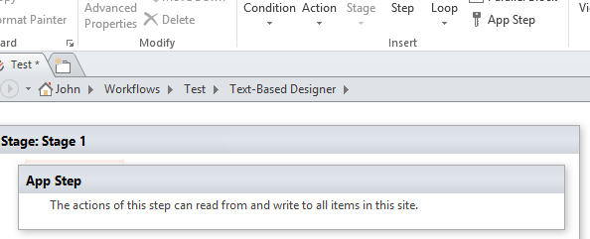
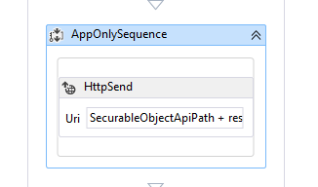
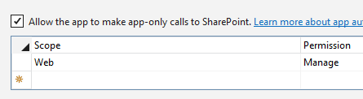
App-Step
Its like Impersonation Step, but better

Slide 6
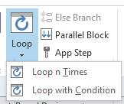
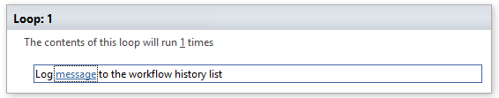
Loopy!

Slide 7
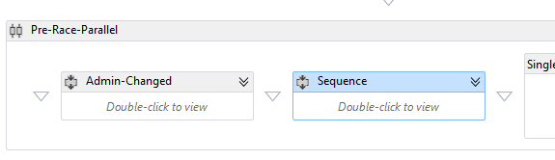
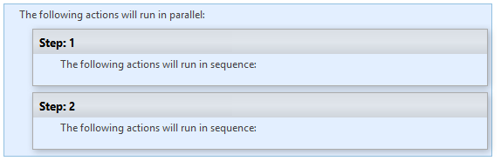
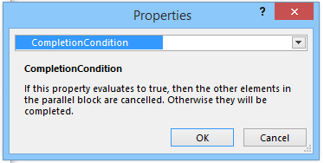
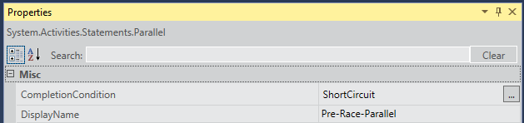
Parallel Actions
by default all steps have to complete.
With Short-Circuit, stop when set to true
Notes:
Any tasks created in parallel are destroyed. Deleted and set to site recycle bin.

Slide 8
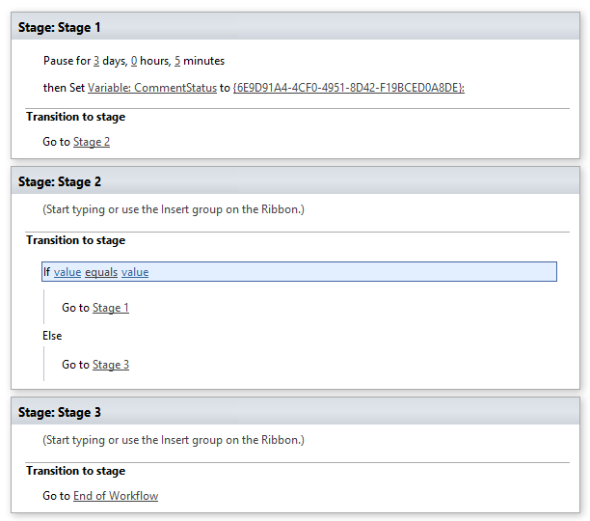
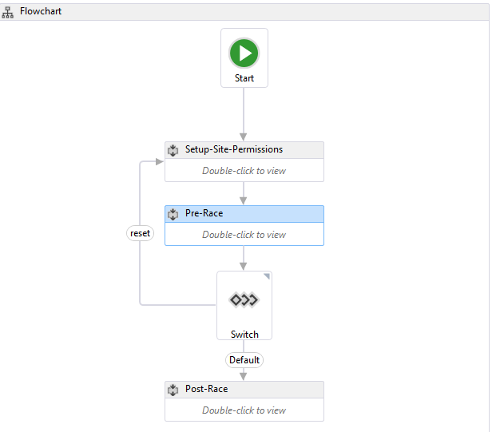
Flow-Chart
Scoped Variables

Slide 9
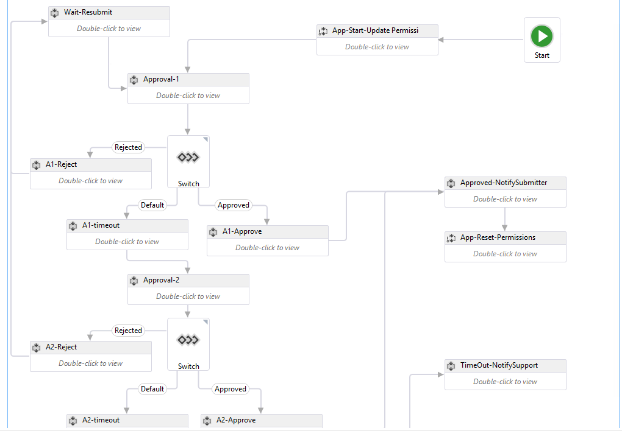

Slide 10
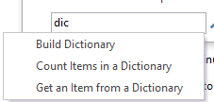
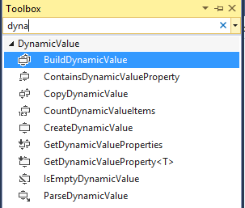
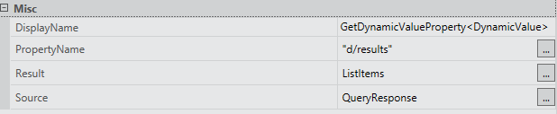
DynamicValue type and JSON
{
value1: “hi”,
value2: 41
}
{ d: {
results : {
…
}
}
}

Slide 11
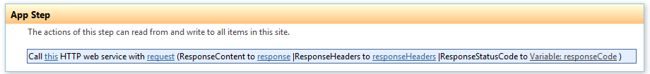
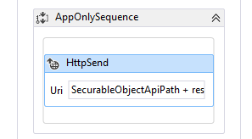
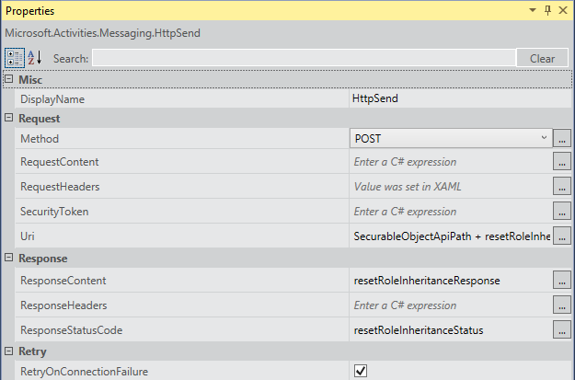
Call HTTP

Slide 12
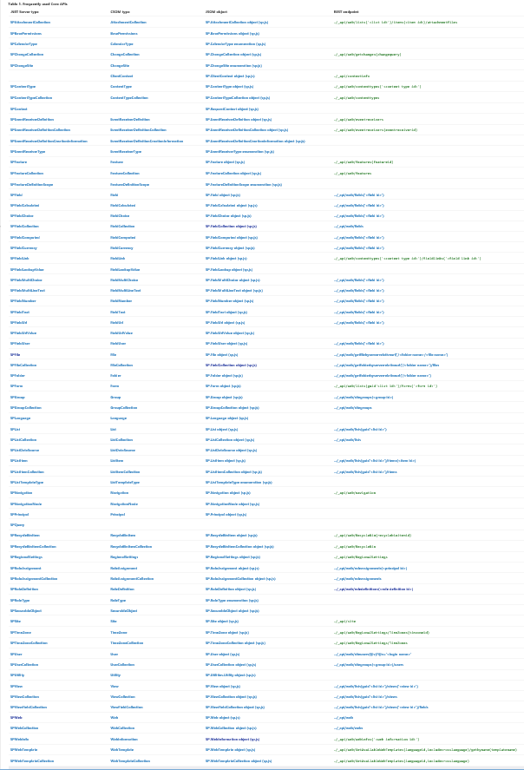
All Hail the REST API
http://msdn.microsoft.com/en-us/library/office/jj860569(v=office.15).aspx
This is the BEST thing in this slide deck
Notes:
http://msdn.microsoft.com/en-us/library/office/jj860569(v=office.15).aspx

Slide 13
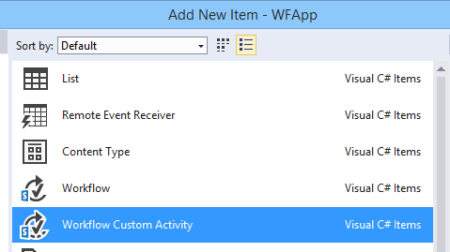
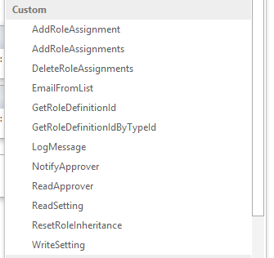
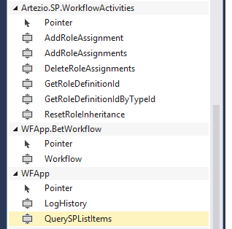
Workflow Custom Activity
This is the SECOND BEST thing in this slide deck

Slide 14
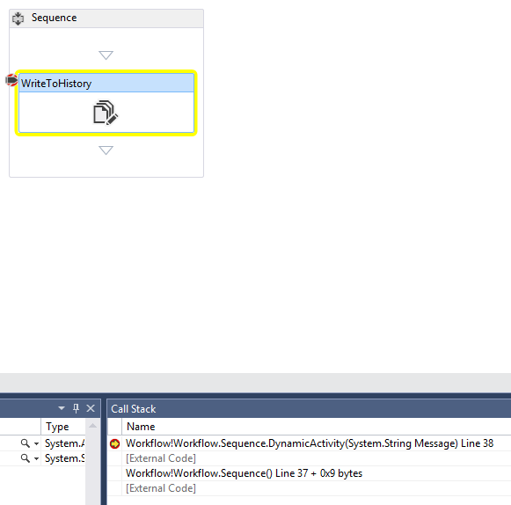
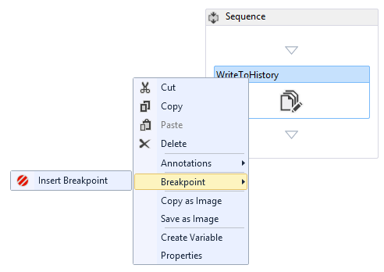
Debugging

Slide 15
Demo App

Slide 16
Setup Workflow
Grants only contribute to Sweep Admin for Lists: Sweep, AppSettings, Horses and Bets.
Grants only contribute to Sweep Admin for List: Quick Links, and Read to Everyone for "Place Bet" list item only.
Authenticated Users has Read to entire site, and Add List Item to Bets
Parallel
Wait for Sweep Admin user to change - repeat first step
Wait until one hour before race
Change picture to running.
And no click for "Place Bets"
No Add Item for users
Wait until after race to email Sweep Admin to update the winners in AppSettings (done via a task)
Sleep/Wait until all bets are calculated, then send email summary to Sweep Admin
End Workflow
Bet Workflow
Find random unassigned horse from bets for that sweep.
"scratched horses" can't be selected after scratched.
If no horse remaining - (delete the bet, email Better, email Sweep Admin to create a new sweep)
Assign Horse and email Better.
Wait until 1 day before race
email better if money not collected, CC Sweep Admin
Wait until after race. (if Winners not selected, keep waiting)
For Each bet:
calculate total sum of bets from 'all bets in that sweep'
Winner takes 40% of pot
2nd takes 30%
3rd takes 20%
Wooden Spoon takes 10%
Update bets's list.
End Workflow

Slide 17
Demo summary
App-Step,
Parallel Actions, Short-circuit
Flow-Chart, Scoped Variables
Call HTTP, REST, DynamicValue
Workflow Custom Activity

Slide 18
The near future - Integrated Workflow Apps
http://www.vrdmn.com/2014/09/integrated-workflow-apps-deploy.html
Add:
<SPIntegratedWorkflow xmlns="http://schemas.microsoft.com/
sharepoint/2014/app/integratedworkflow"> <IntegratedApp>true</IntegratedApp> </SPIntegratedWorkflow>

Slide 19
Links
http://msdn.microsoft.com/en-us/library/office/jj163199(v=office.15).aspx

Slide 20
Closing Thought
You can build very interesting apps
There are no C# code
There are no Javascript code
Is Workflow “code”? ☺

Slide 21

Questions?
Comments?
More info
John.Liu@SharepointGurus.net
@johnnliu http://JohnLiu.net
Grab my business card!

Slide 22
Thanks for listening
Remember to submit your feedback
John.liu@sharepointgurus.net
@johnnliu
johnliu.net

