Slide 1
Creating Knockout User Experiences in SharePoint with JavaScript
Making awesome with Knockout, jQuery and SharePoint REST

Slide 2
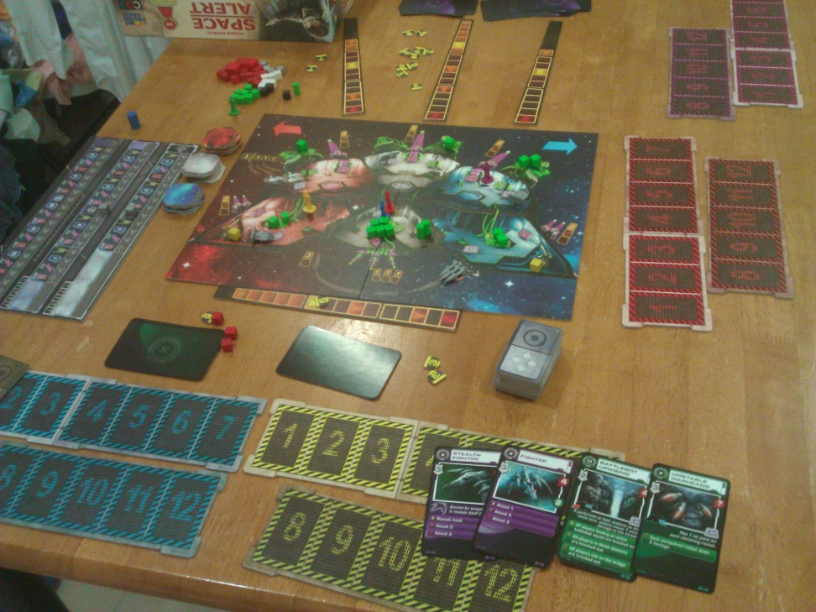
about John Liu
Senior Consultant for SharePoint Gurus Sydney
http://johnliu.net
Community: user groups, SharePoint Conferences and SharePoint Saturday
@johnnliu
Loves .NET - SharePoint 2007, 2010, Silverlight & Windows Phone
Video games, board games, D&D
Notes:
Keith (geek in training), cheating his dice roll while I'm taking this picture because he didn't get enough skulls to hit the ogre.

Slide 3
Contents
Demo, demo, demo (5 demos)
Tricks
Risks
Related techniques

Slide 4
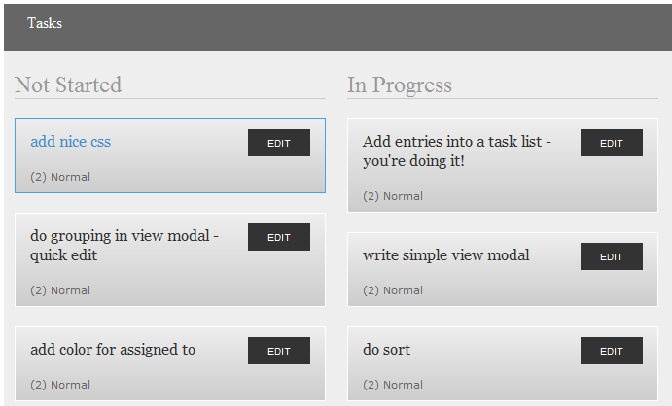
Picture - build this in 1 sesson

Slide 5
Demo - ko
… 0

Slide 6
Demo - ko.mapping
… 1

Slide 7
Demo - SP2010 REST
… 2
listdata.svc
GET interface

Slide 8
Demo - SP2010 REST
… 3
POST
MERGE
Remember e-tag

Slide 9
Demo - crazy
… everything!

Slide 10
A real world example
<picture removed>
Notes:
NOTE: remove when publish this PPTX
Permission from client to show in demo, but not for online distribution

Slide 11
Current issues
Debugging is not as great as Visual Studio. You'll need to know how to use the browser's JavaScript debugger fairly well
Not all binding errors show up in the console log - sometimes you only see an error when you debug
It is possible to create circular dependency graphs and then your JavaScript will slow to a dog!

Slide 12
Tricks
IE developer toolbar
Using HTML inspector
Using JavaScript debugger
Using Network inspector

Slide 13
Risk: Is this mainstream?
Knockout is created as an open source project, by Steve Sanderson. Who is actually a Microsoft Program Manager in the ASP.NET team.
There are other template engines but they aren't as mature - some are still in beta. Knockout is stable and in version 2 already.
Has been proven to work for ASP.NET WCF, ASP.NET MVC, Ruby on Rails, and now SharePoint
Knockout supports other template engine as plugins.

Slide 14
Risk: looks difficult
A good grasp of the concepts is the right starting point
Go through the demos and experiment, use that as a reference to build your own UI
Developers with Silverlight/MVVM experience will find this is a good way to reunite that skillset back into client-side HTML
Developers with ASPNET MVC experience will also find this a lot easier

Slide 15
What about if you can't use REST?
Use the client object model, load SPItem via SP.ClientContext then use ko.mapping
In SP2007, you can also use SPServices.codeplex.com which is a JavaScript wrapper library around SharePoint 2007/2010 SOAP Services
Use KO with your own custom REST services

Slide 16
Whoa! We don't do dirty Content Editor webparts!
Take the entire content of the html file, and put it into a sandbox visual web part. This will create a sandbox solution and you can deploy that within your site collection
Notes:
You will find that as fast as sandbox webparts are to deploy, SharePoint Designer is super fast (faster than even ASPNET MVC's deploy cycle)

Slide 17
Downloads
Knockout: http://knockoutjs.com/
Knockout.Mapping: https://github.com/SteveSanderson/knockout.mapping/tree/master/build/output

Slide 18
References
SP2010 REST - http://msdn.microsoft.com/en-us/library/ff798339.aspx
http://knockoutjs.com/documentation/introduction.html
https://www.nothingbutsharepoint.com/sites/devwiki/articles/Pages/Applying-the-MVVM-pattern-to-create-SharePoint-list-driven-interactive-tools-using-Knockout.aspx
https://www.nothingbutsharepoint.com/sites/devwiki/articles/Pages/SharePoint-Development-Using-HeadJS-KnockoutJS-And-SPServices.aspx

Slide 19
References
SPServices - https://www.nothingbutsharepoint.com/sites/eusp/Pages/jQuery-Library-for-SharePoint-Web-Services-(SPServices)-v0.7.1-Released-.aspx
@spmatt_menezes

Slide 20
Summary
Saw lots of demos
Tricks
Risks
Related techniques

Slide 21
John.Liu@SharepointGurus.net
@johnnliu http://JohnLiu.net

